Slide 1
Dast-e-Khair
Muhammad Ahmad Aziz (21L-1873)
Muhammad Ahmed Akram (21L-1833)
Muhammad Arsalan Kashif (21L-7630)
Supervisor: Mr. Hafiz Usama Hassan Alvi

Slide 2
OUTLINE
Introduction
Problem Statement
Goals and Objectives
System Architecture and Design
Prototype Demonstration
Future Goals

Slide 3

INTRODUCTION
The purpose of today’s presentation is to take a closer look at the progress we have made in this phase of our project so far.

Slide 4
PROBLEM STATEMENT
There is no system in Pakistan that offers multiple options to donate.
Smaller NGOs often remain unseen.
Donors face difficulties when they want to donate more than just money.
NGOs need a fast way to gather volunteers and supplies.
Notes:
There is no system in Pakistan that offers multiple options to donate. The existing organizations including
alkhidmat, akhuwat, etc, they only allow monetary donations and some of the organizations take only food.
Smaller NGOs oftem remain unseen and becuase of this some needy people do not get what they need. During
disasters and emergencies, NGOs often face difficulties while gathering volunteers and they need a faster
way to gather volunteers and supplies.

Slide 5

GOALS & OBJECTIVES
Create a Unified Donation Platform
Support Smaller NGOs
Enhance User Experience
Offer Diverse Donation Options
Emergency Volunteer Mobilization
Notes:
All the mentioned problems are solved by Dast e khair. We will create a unified donatiion platform which will
offer diverse donation options. Recognizing that giving is not just about money, it can also be food, clothes
or medicines, in fact anything which can help a person who is in need of that. Enhance user Experience
by creating an easy-to-navigate interface that helps users to contribute with just a
few taps. Our platform will support smaller NGOs by providing them an application which they will operate
and through which they manage donation. In this way they will be able to request and gather volunteers
during emergencies.

Slide 6
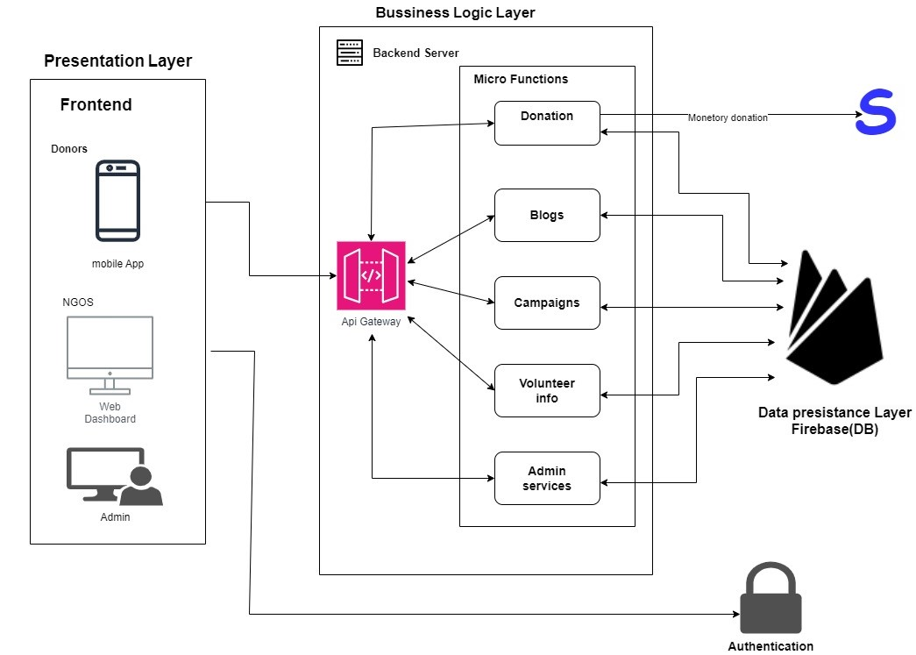
SYSTEM ARCHITECTURE & DESIGN

Slide 7
ACHIEVED GOALS
Problem Identification
Proposed Solution
Project Modularization
System Architecture Design
Documentation
Backend APIs
Home Page
Campaigns
Goodness posts
Notes:
This slide explains the key parts of our project. First, we identified the problem and came up with a solution to solve it. Next, we divided the project into smaller modules to make it easier to build and manage. Then, we designed the system’s structure and created the backend APIs to handle data and processes. Finally, we worked on the Home Page, Campaigns, and Goodness Posts sections to give users a smooth and engaging experience.

Slide 8
Prototype DEMO !!

Slide 9
FUTURE GOALS
Front-End : Code Completion & Optimization - Unit Testing
Integration : Integration testing + System Testing
Back-End : Code Optimization - Error Handling - Unit Testing
Admin-Dashboard: For Admin operations
Deployment : User Acceptance Testing
Documents : User Manuals - FYP2 Report
Maintenance : Regular Updates & Patching
Notes:
This slide shows what we plan to do next for our project. First, for the Front-End, we will finish the code, make it run faster, and test small parts to make sure they work correctly. Then, for Integration, we will put all the pieces together and test how they work as a whole system. For the Back-End, we will improve the code, fix errors, and test it in parts too. Next, during Deployment, we will check if real users are happy with the app. In Documents, we will write user guides and complete our final project report. Finally, for Maintenance, we will keep updating the app and fixing any new problems.

Slide 10
Thank You !

